Slide 1
CND212: Digital Testing and Verification

Slide 2
SystemVerilog Routines

Slide 3
Subroutines (task & function)
Tasks and functions provide the ability to execute common procedures from several different places in a code.
They also provide a means of breaking up large procedures into smaller ones to make them easier to read and debug.
Tasks and functions are collectively referred to as subroutines

Slide 4
Subroutines (task & function)
Functions
Cannot block
Can’t have time-controlling statements such as @(posedge clk)
The statements in the body of a function execute in one simulation time unit
A non-void function must return a single value
SystemVerilog improves this by adding (void function) which does not return a value
Cannot enable a task
Tasks
Can block
May contain time-controlling statements
Does not return a value
Can enable other tasks and/or functions

Slide 5
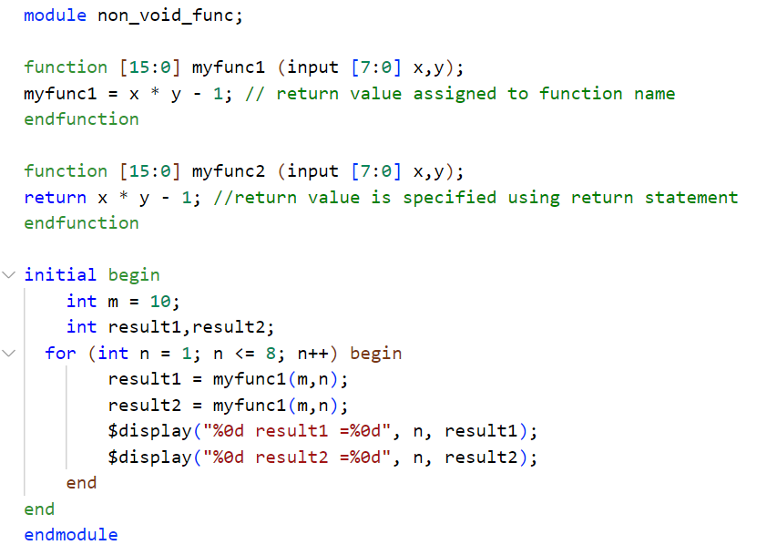
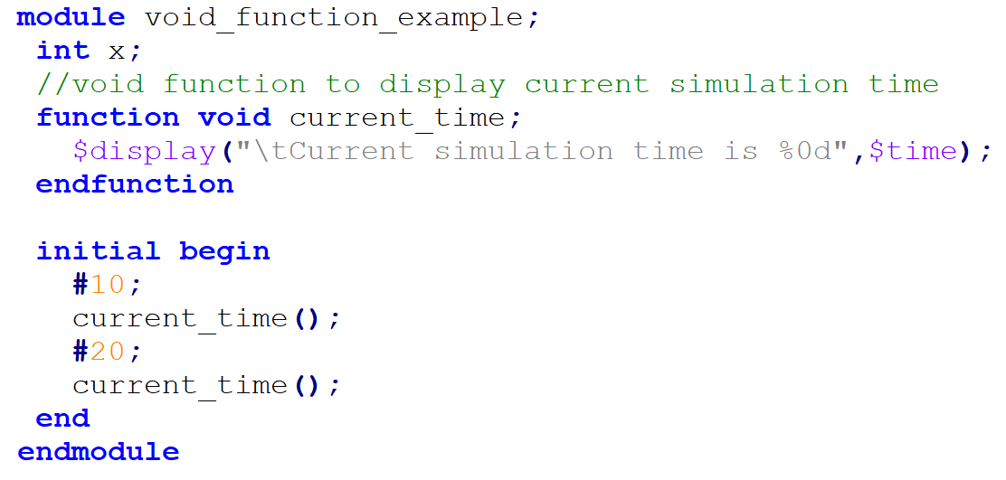
Subroutines (task & function) - example

Slide 6
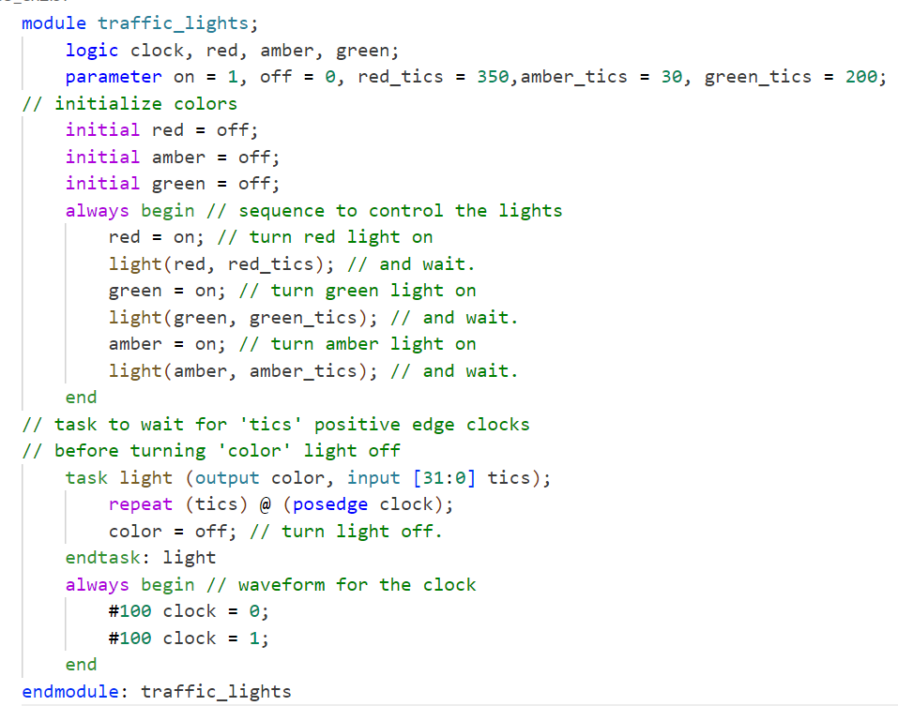
Subroutines (task & function) - example

Slide 7
Task/function Memory Usage
Static
Tasks/functions are static by default except if they are declared inside a class scope
All variables of a static task/function are static by default
Static variables retain their value between invocations
There is a single static variable corresponding to each declared local variable in a module instance, regardless of the number of concurrent activations of the task/function.
Static tasks/functions in different instances of a module have separate storage from each other
Automatic
Allocate unique, separate storage for each task/function call
All variables of an automatic task/function are automatic by default
Automatic variables do not retain their values between invocations
Automatic variables are replicated on each concurrent task/function invocation

Slide 8
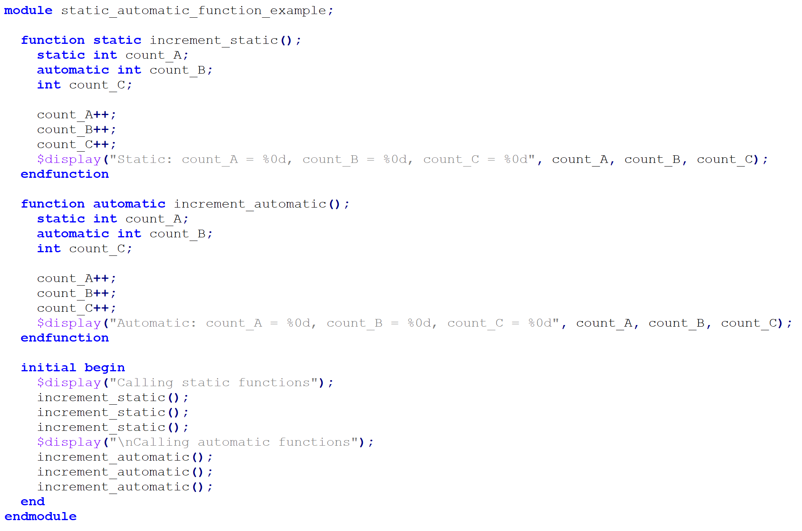
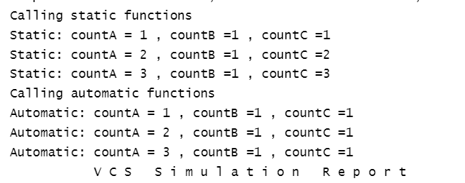
Task/function Memory Usage - example

Slide 9
Functions vs Tasks - Summary
Function | Task
It cannot contain simulation delay, so it executes in the same time unit. | Can contain a simulation time delay and include time-controlling statements
Can return a single value unless it is a void function | Does not return a value but can achieve the same effect using output arguments
Cannot call another task | Can call another function or task

Slide 10
SystemVerilog Threading

Slide 11
fork – join (Parallel blocks)
There are two types of blocks in SystemVerilog
Sequential blocks
begin – end block
Parallel blocks
fork – join block
The parallel block is delimited by the keywords fork and join, join_any, or join_none.
The procedural statements in a parallel block is executed concurrently (in parallel)

Slide 12
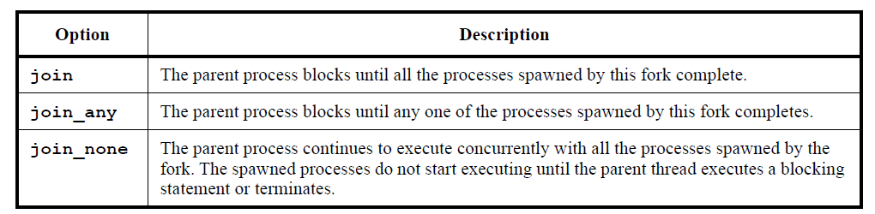
fork – join (Parallel blocks)
SystemVerilog provides three choices for specifying when the parent (forking) process resumes execution

Slide 13
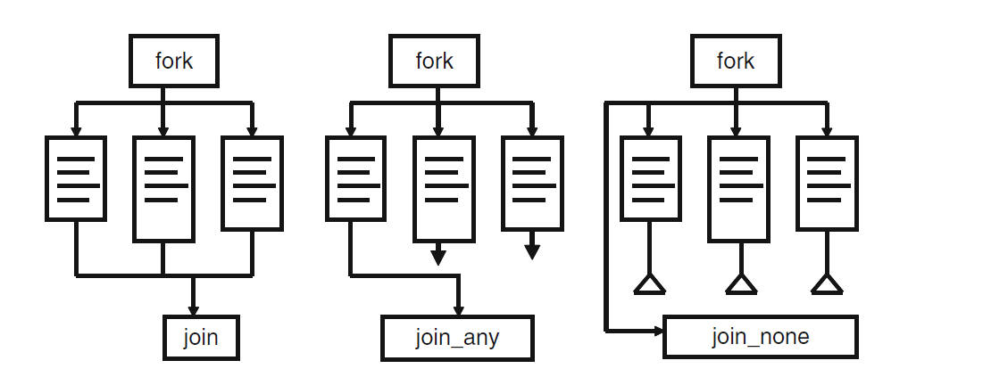
fork – join (Parallel blocks)

Slide 14
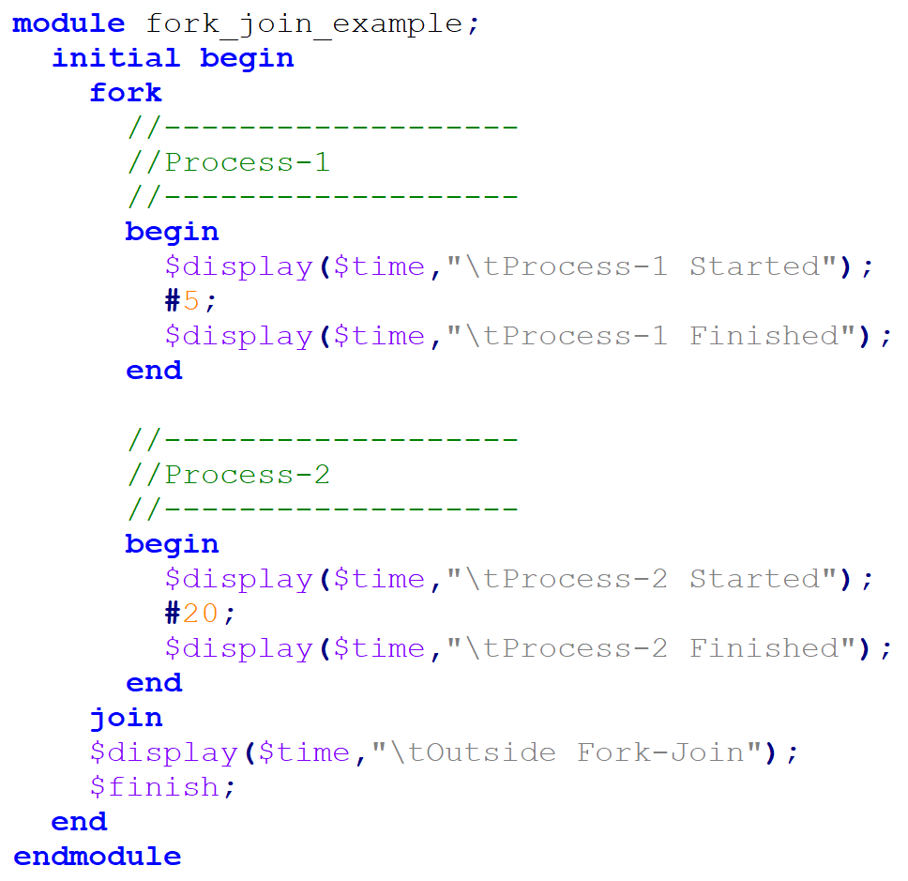
fork – join (example1)
Example1: fork - join
fork block will be blocked until the completion of process-1 and Process-2.
Both process-1 and Process-2 will start at the same simulation time
Process-1 will finish at 5ns
Process-2 will finish at 20ns.
fork-join will be unblocked at 20ns.
Sequential blocks
Notes:
When defining a fork-join block, encapsulating the entire fork within a begin-end block causes the entire
block to execute as a single process, with each statement executing sequentially

Slide 15
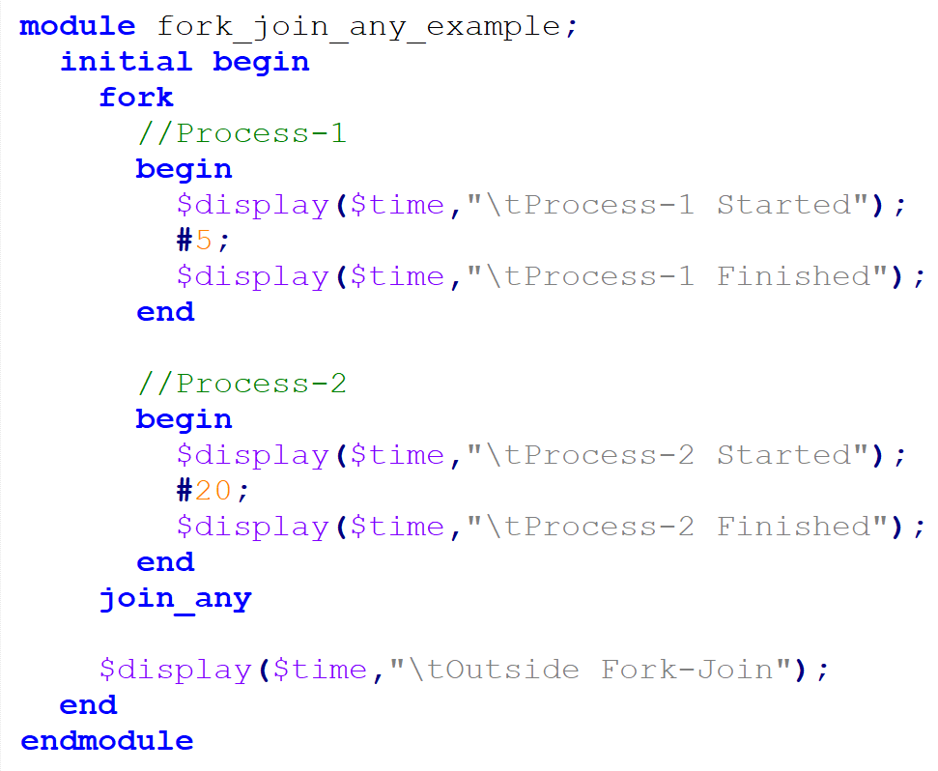
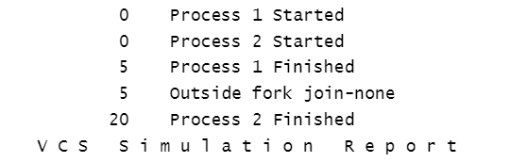
fork – join_any (example2)
Example2: fork – join_any
The fork block will be blocked until the completion of any of the processes, Process-1 or Process-2.
Both Process-1 and Process-2 will start at the same simulation time,
Process-1 will finish at 5ns
Process-2 will finish at 20ns
fork-join_any will be unblocked at 5ns.

Slide 16
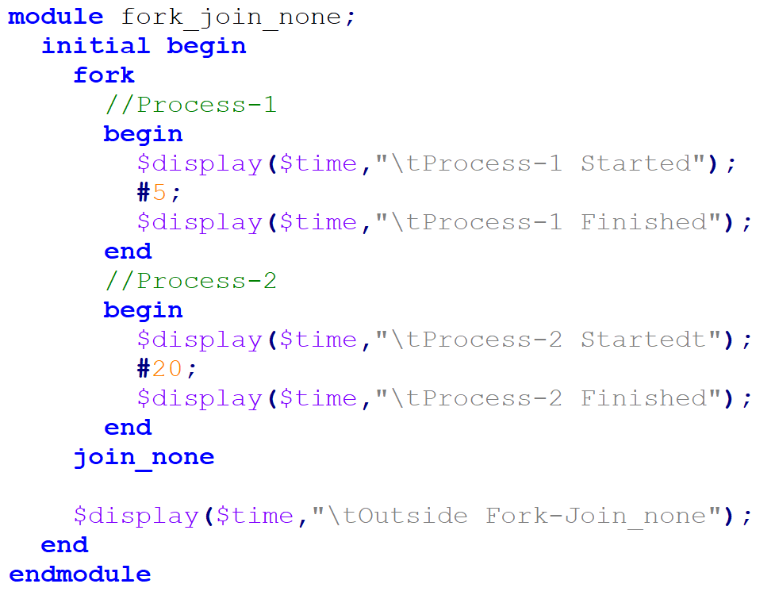
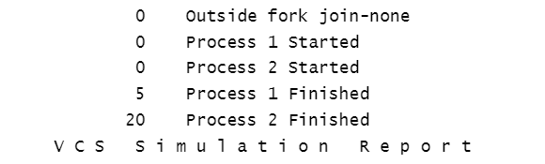
fork – join_none (example3)
Example3: fork – join_none
The fork will start Process-1 and Process-2 at the same time, and it will come out of the block.
Process-1 and Process-2 will be executed until they are completed.

Slide 17
fork – join (Parallel blocks)
Summary
For sequential blocks, the start time is when the first statement is executed, and the finish time is when the last statement has been executed.
For parallel blocks, the start time is the same for all the statements, and the finish time is controlled by the join construct used
Sequential and parallel blocks can be embedded within each other, allowing complex control structures to be expressed easily and with a high degree of structure.

Slide 18
SystemVerilog Interprocess Synchronization & Communication

Slide 19
Overview
Verilog provides basic synchronization mechanisms that are adequate at the hardware level (i.e. @)
This type of control is adequate for static objects but falls short in a dynamic and highly reactive testbench.
Hence, SystemVerilog adds the following communication mechanisms:
Semaphores
built-in class, which can be used for synchronization and mutual exclusion to shared resources
Mailboxes
built-in class, which can be used as a communication channel between processes

Slide 20
Semaphore
semaphore identifier_name;
Conceptually, a semaphore is a bucket.
When a semaphore is allocated, a bucket containing a fixed number of keys is created
Processes using semaphores must first get a key from the bucket before executing.
All other processes must wait until a sufficient number of keys is returned to the bucket.

Slide 21
Semaphore Methods
Method name | Description
new() | To create a semaphore with a specified number of keys
get() | To obtain or get a specified number of keys
put() | To put or return the number of keys
try_get() | Try to obtain or get a specified number of keys without blocking the execution

Slide 22
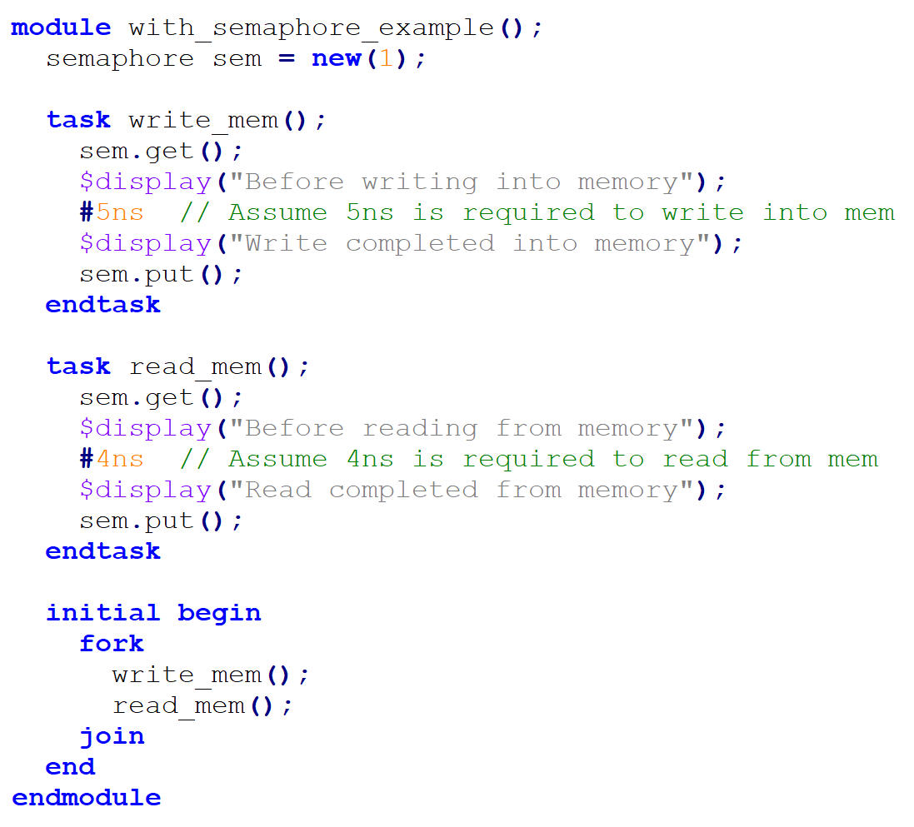
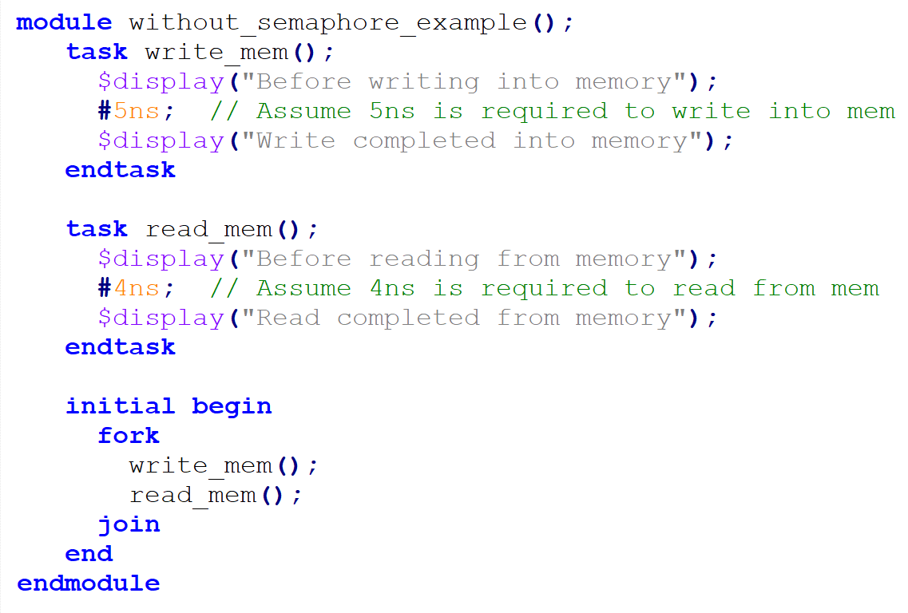
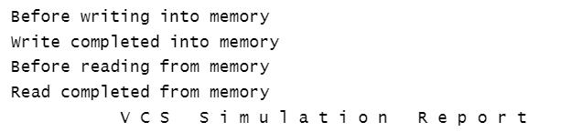
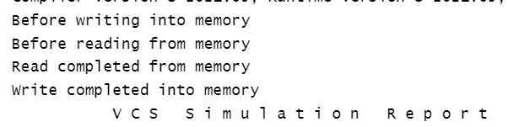
Semaphore – Example 1

Slide 23
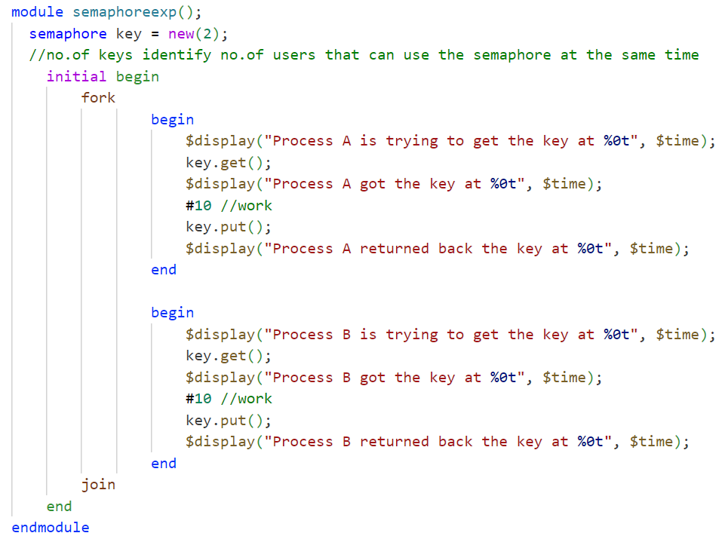
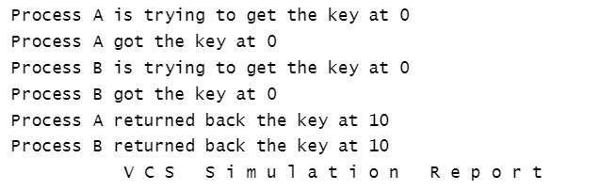
Semaphore – Example 2
Get single key per process

Slide 24
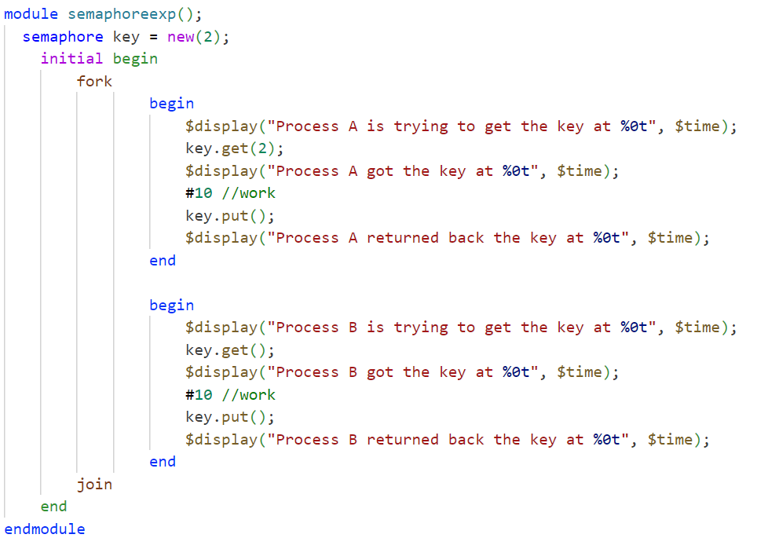
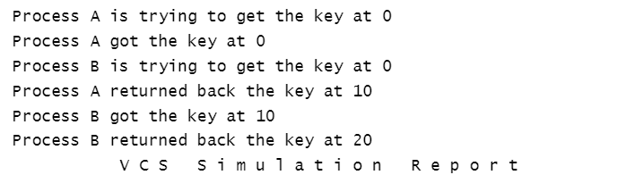
Semaphore – Example 3
Get multiple keys per process

Slide 25
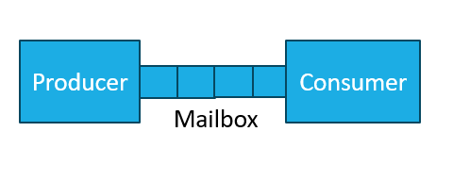
Mailbox
mailbox #(type) identifier_name;
A mailbox is a communication mechanism that allows messages to be exchanged between processes.
Data can be sent to a mailbox by one process and retrieved by another.
Mailbox behaves as first-in-first-out (FIFO), with a source and sink

Slide 26
Mailbox Methods
Method name | Description
function new(int bound = 0) | Returns mailbox handle. An argument represents bounded mailbox size otherwise, it is an unbounded mailbox
task put(<data>) | Blocking method that stores data in the mailbox.
function int try_put(<data>) | The non-blocking method that stores data in the mailbox if it is not full and returns 1 else 0.
task get(ref <data>) | Blocking method to retrieve data from the mailbox
function int try_get(ref <data>) | The non-blocking method which returns data if a mailbox is non-empty else returns 0.
task peek(ref <data>) | Copies data from the mailbox without removing it from a mailbox
function int try_peek(ref <data>) | Tries to copy data from the mailbox without removing it from a mailbox
function int num() | Returns number of entries in the mailbox

Slide 27
Mailbox – bounded/unbounded
Mailbox is unbounded by default.
It can be bounded by passing the required size to its new function.
A bounded mailbox becomes full when it contains the bounded number of messages.
When the source thread tries to put a value into a sized mailbox that is full, that thread blocks until the value is removed.
Likewise, if a sink threads tries to remove a value from an empty mailbox, that thread blocks until a value is put into the mailbox
Unbounded mailboxes never suspend a thread in a send operation.

Slide 28
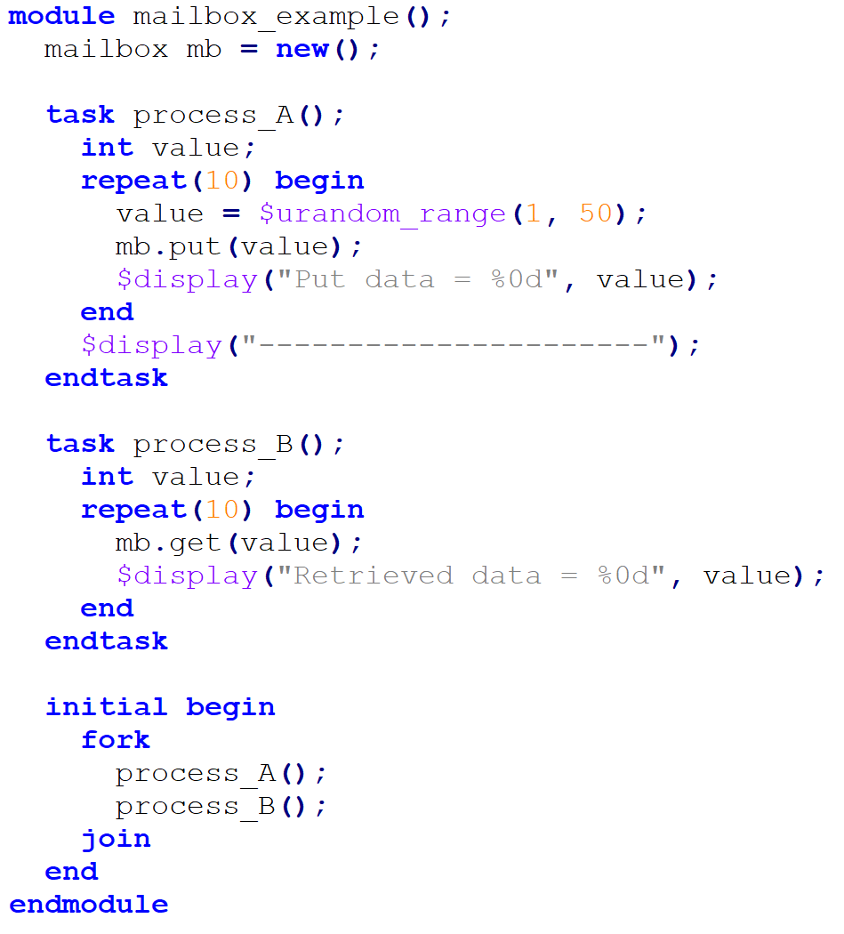
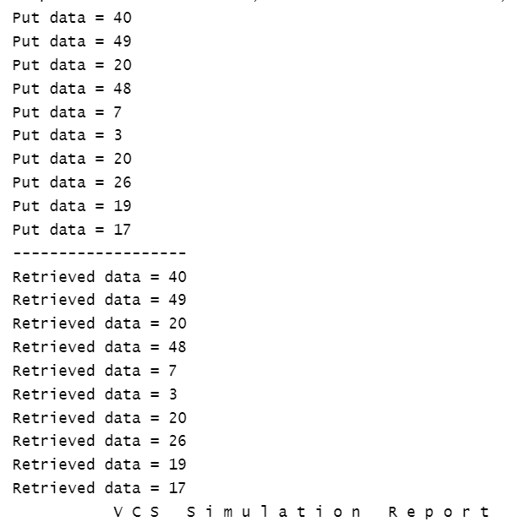
Mailbox – example

Slide 29
Lab 3: (~ 60 min)

Slide 30
Lab Task: Producer-Consumer Model
In this lab, a producer and consumer model can be designed using the pre-defined packet data type, SystemVerilog mailbox, and tasks as follows:
Create a packet that has:
ID
Sent_time
packet_type
data
Types of packets are:
Message
Command
Control
Create a task for a producer that writes in the mailbox every 10ns.
Create a task for a consumer that reads from the mailbox every 5ns.
Use fork-join to synchronize between them.
Randomize multiple packets and send them from the producer in a fixed time interval.

Slide 31
Assignment: (~ 60 min)

Slide 32
Assignment: Producer-Consumer Model with priorities
For the lab assignment, a producer and consumer model can be designed using the pre-defined packet data type, SystemVerilog mailbox, and tasks as follows:
Create a packet that has: ID, Sent_time, packet_type, priority and data.
Types of packets are Message, Command, and Control.
There are three levels of priority:
High
Medium
Low
Create a task for a producer that writes in the mailbox every 5ns
Create a task for a consumer that reads from the mailbox every 20ns but reads the packets with higher priority first.
Use fork-join to synchronize between them.
Randomize multiple packets and send them from the producer in a fixed time interval.

